Slide 1
Lecture 03
CSE 3213
Computer graphics
Drawing Elementary Figures

Slide 2
Primitive graphic objects
Computer-generated images are produced using primitive graphic objects such as:
  Points
  Straight lines
  Circles

Slide 3
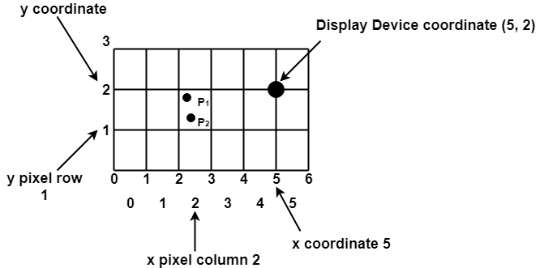
Scan Converting a Point

Slide 4
Scan Converting a Point
A mathematical point (x,y) where x and y are real numbers within an image area need to be converted to a pixel at location (x’,y’)
This may be done by making x’ to be integer part of x and y’ the integer part of y.

Slide 5
Line Drawing
Many computer-generated pictures are composed of straight-line segments.
A line segment is displayed by turning on a set of adjacent pixels.
In order to draw a line, it is necessary to determine which pixels lie nearest the line and provide the best approximation to the desired line.
The line drawing routine should be accurate, fast, and easy to implement.

Slide 6
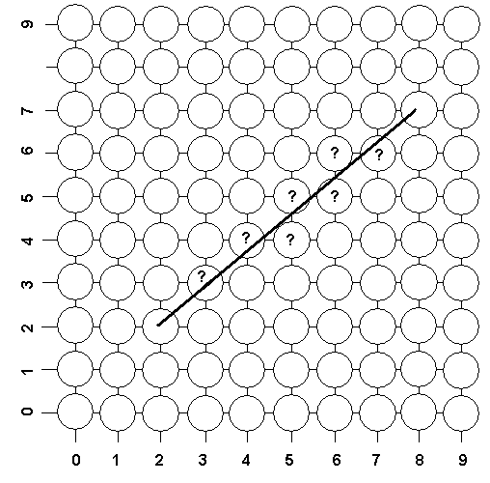
The Problem of Scan Conversion
Scan Conversion is the process of representing continuous graphics object as a collection of discrete pixels. It is the responsibility of graphics system or the application program to convert each primitive from its geometric definition in coordinate system .A line segment is defined by the coordinate positions of the line endpoints.
We have a line with the endpoints (2,2) and (8,7) and we want to draw this line on a pixel based display.
How do we choose which pixels to turn on?

Slide 7
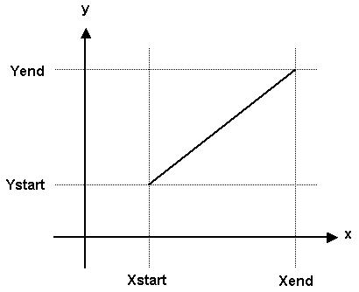
Slope-Intercept Line Equation
A line segment in a scene is defined by the coordinate positions of the line endpoints. The starting point is (Xstart, Ystart) and the ending point is (Xend, Yend).

Slide 8
Slope-Intercept Line Equation
Line Equation is defined as:
y = m x + b
Where m is the slope of the line, and defined as the change in y values divided by the change in x values:
m= | Yend – Ystart
 | Xend – Xstart
b is the y-intercept. Recall that the y-intercept is the line’s y value when x equals zero.
For example, the line defined by equation y=5x+3 the y-intercept is b=3.

Slide 9
Slope-Intercept Line Equation
The y-intercept can be calculated by the following equation in terms of the coordinate of the starting points.
b = Ystart – m Xstart
The y-intercept can also be calculated by the following equation in terms of the coordinate of the ending points.
b = Yend – m Xend

Slide 10
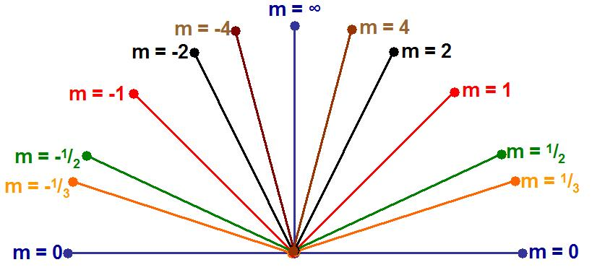
Slope-Intercept Line Equation
The slope of a line (m) is defined by its start and end coordinates. The diagram below shows some examples of lines and their slopes, in all cases b=0.

Slide 11
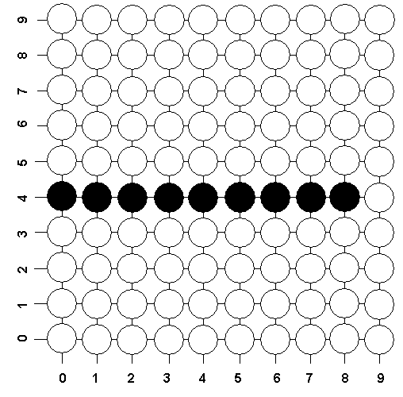
Horizontal Line Drawing Algorithm
The screen coordinates of the points on a horizontal Line are obtained by keeping the value of y constant and repeatedly incrementing the x value by one unit.
horizontal line with starting point (0,4) and ending point (8,4) on a pixel based display

Slide 12
Horizontal Line Drawing Algorithm
The following code can be used to draw a horizontal line from (Xstart, Y) to (Xend, Y),
where Xstart ≤ Xend
x = Xstart
y = Y
Next: Set pixel (x, y) with desired color
x = x + 1
If x ≤ Xend then go to Next
End

Slide 13
End

